Slide 1


Multilevel models
Dr Andy Fugard
Intermediate Quantitative Social Research
4 Feb 2019
a.fugard@bbk.ac.uk

Slide 2
Today
We will cover the last new idea of the module: “random effects”.
The rest will be gluing together everything else we have covered to do increasingly exciting things.
FUTURE YEARS: EXPLAIN REML

Slide 3
The plan for this eve
We started the module with linear regression
for normally distributed data
and saw how it generalises to other distributions for
binary (yes/no) & count data
This week: we will generalise the residuals

Slide 4
So far…
Linear model (regression)
lm(outcome ~ predictors, data = dat)
Generalised linear model (GLM)
glm(outcome ~ predictors, data = dat, family = binomial)
glm(outcome ~ predictors, data = dat, family = poisson)
glm(outcome ~ predictors, data = dat, family = quasipoisson)

Slide 5
Preview of this week’s new command
Linear model (regression)
lm(outcome ~ predictors, data = dat)
Linear mixed-effect model (LMM)
library(lme4)
lmer(outcome ~ predictors + (predictors | group), data = dat)

Slide 6
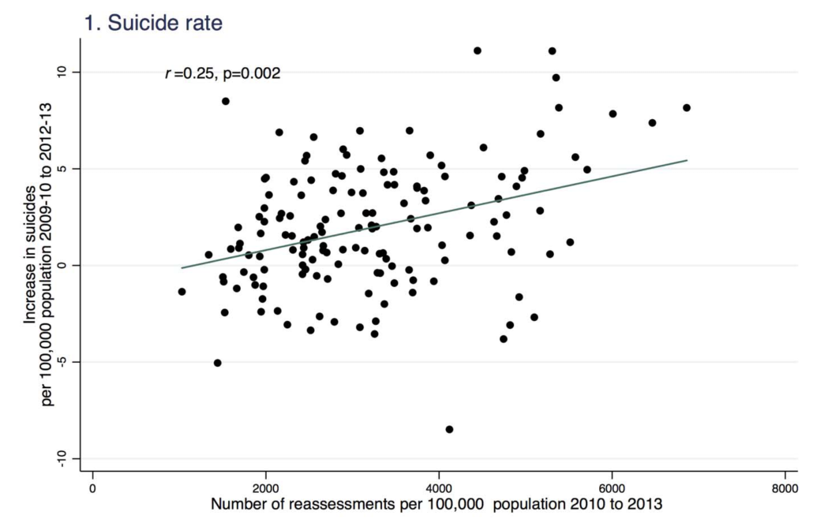
Impact of work capability (re)assessment
Barr et al. (2016)

Slide 7

Multilevel data

Slide 8

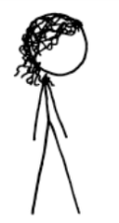










Students are in classrooms

Slide 9
Classrooms are in schools

Slide 10
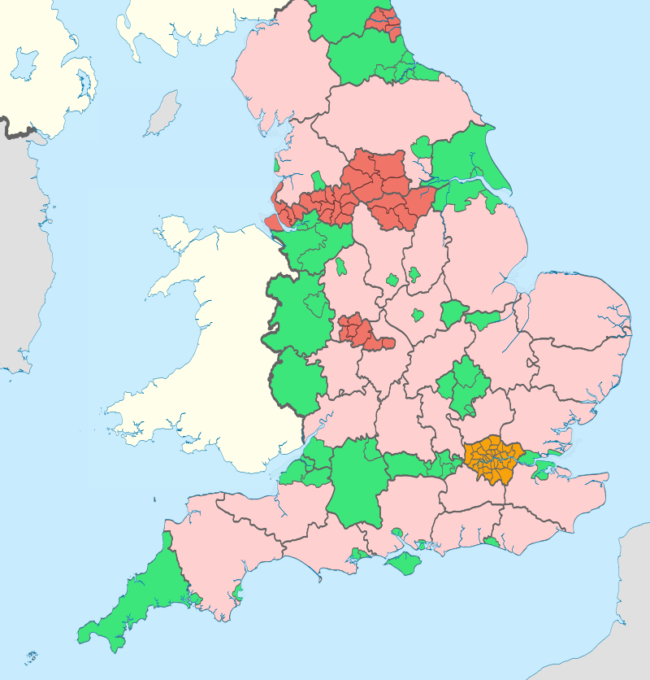

Slide 11
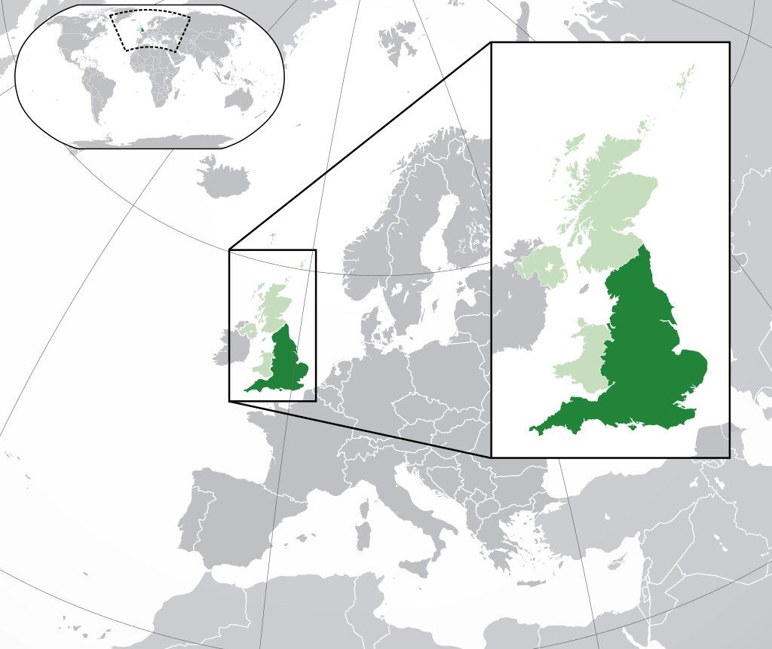

Slide 12
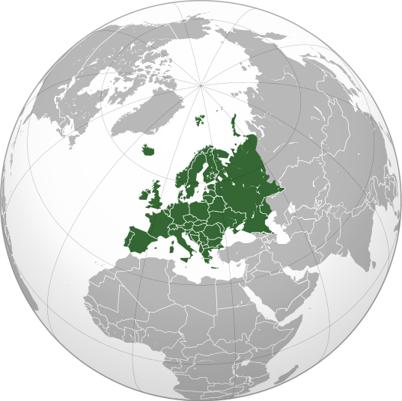

Slide 13


Each student can also be tracked over time (measurements are nested in students)
2015
2016
2017

Slide 14
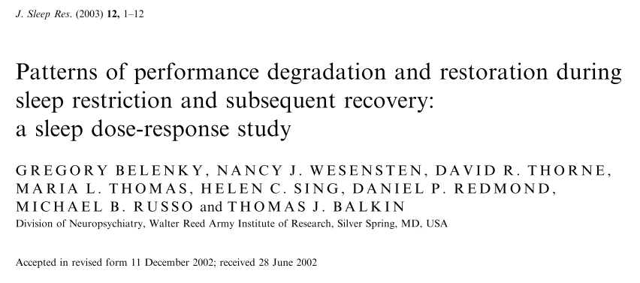

Slide 15
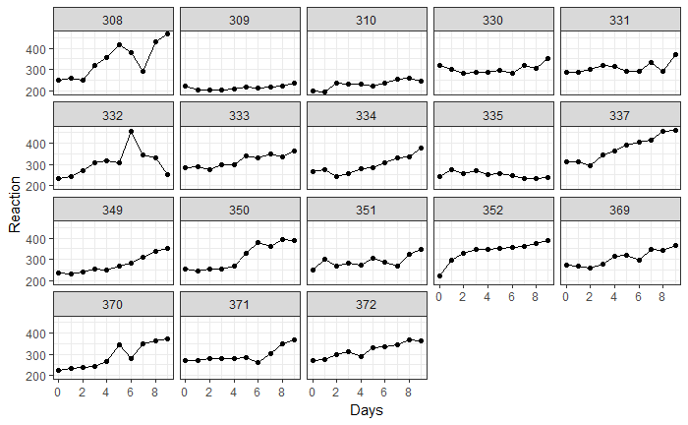

Slide 16
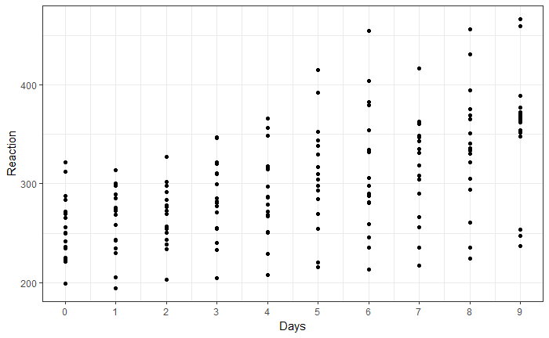

Slide 17
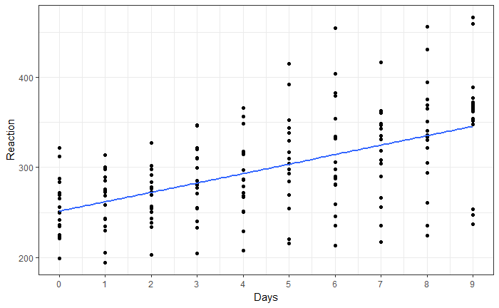
You could just use linear regression…

Slide 18
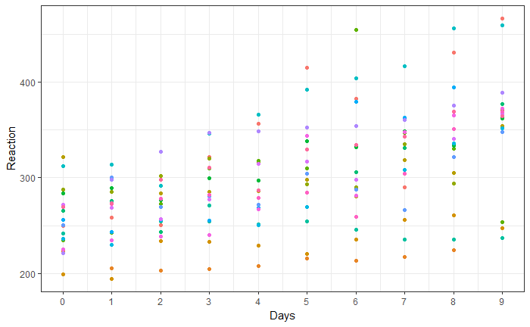
But that doesn’t “know” about the structure of the data

Slide 19
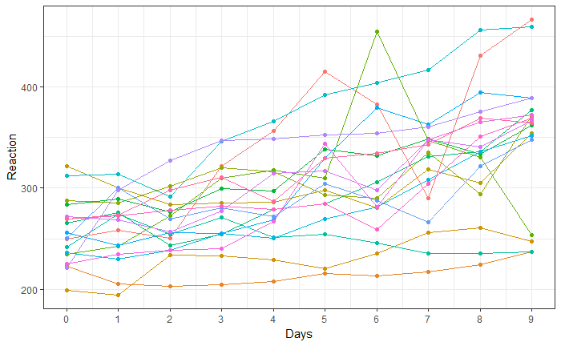

Slide 20
Why not just fit a separate regression model for each participant?

Slide 21
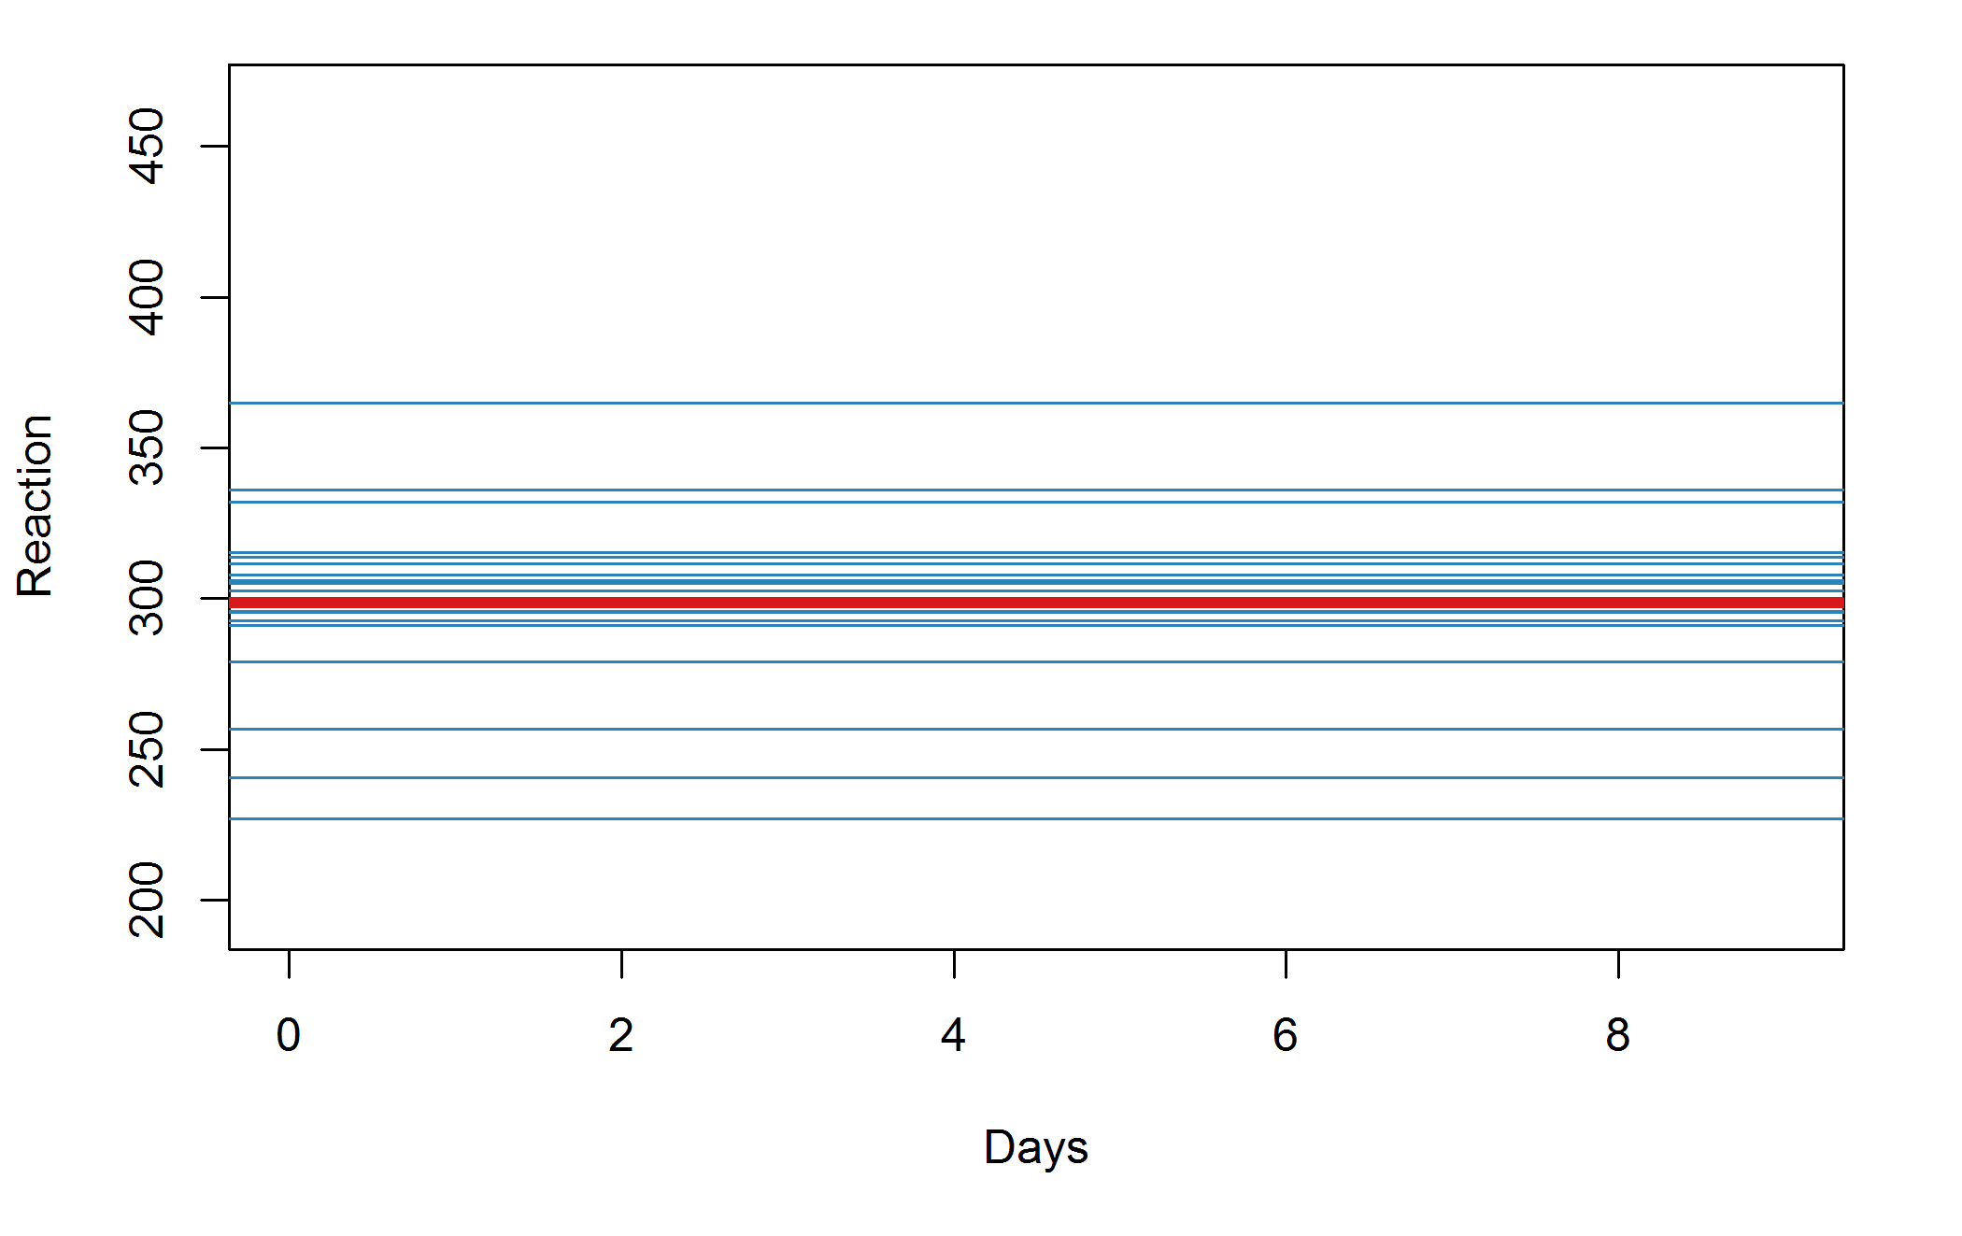
Silly model

Slide 22
Average intercept

Slide 23
Intercept varies by participant

Slide 24
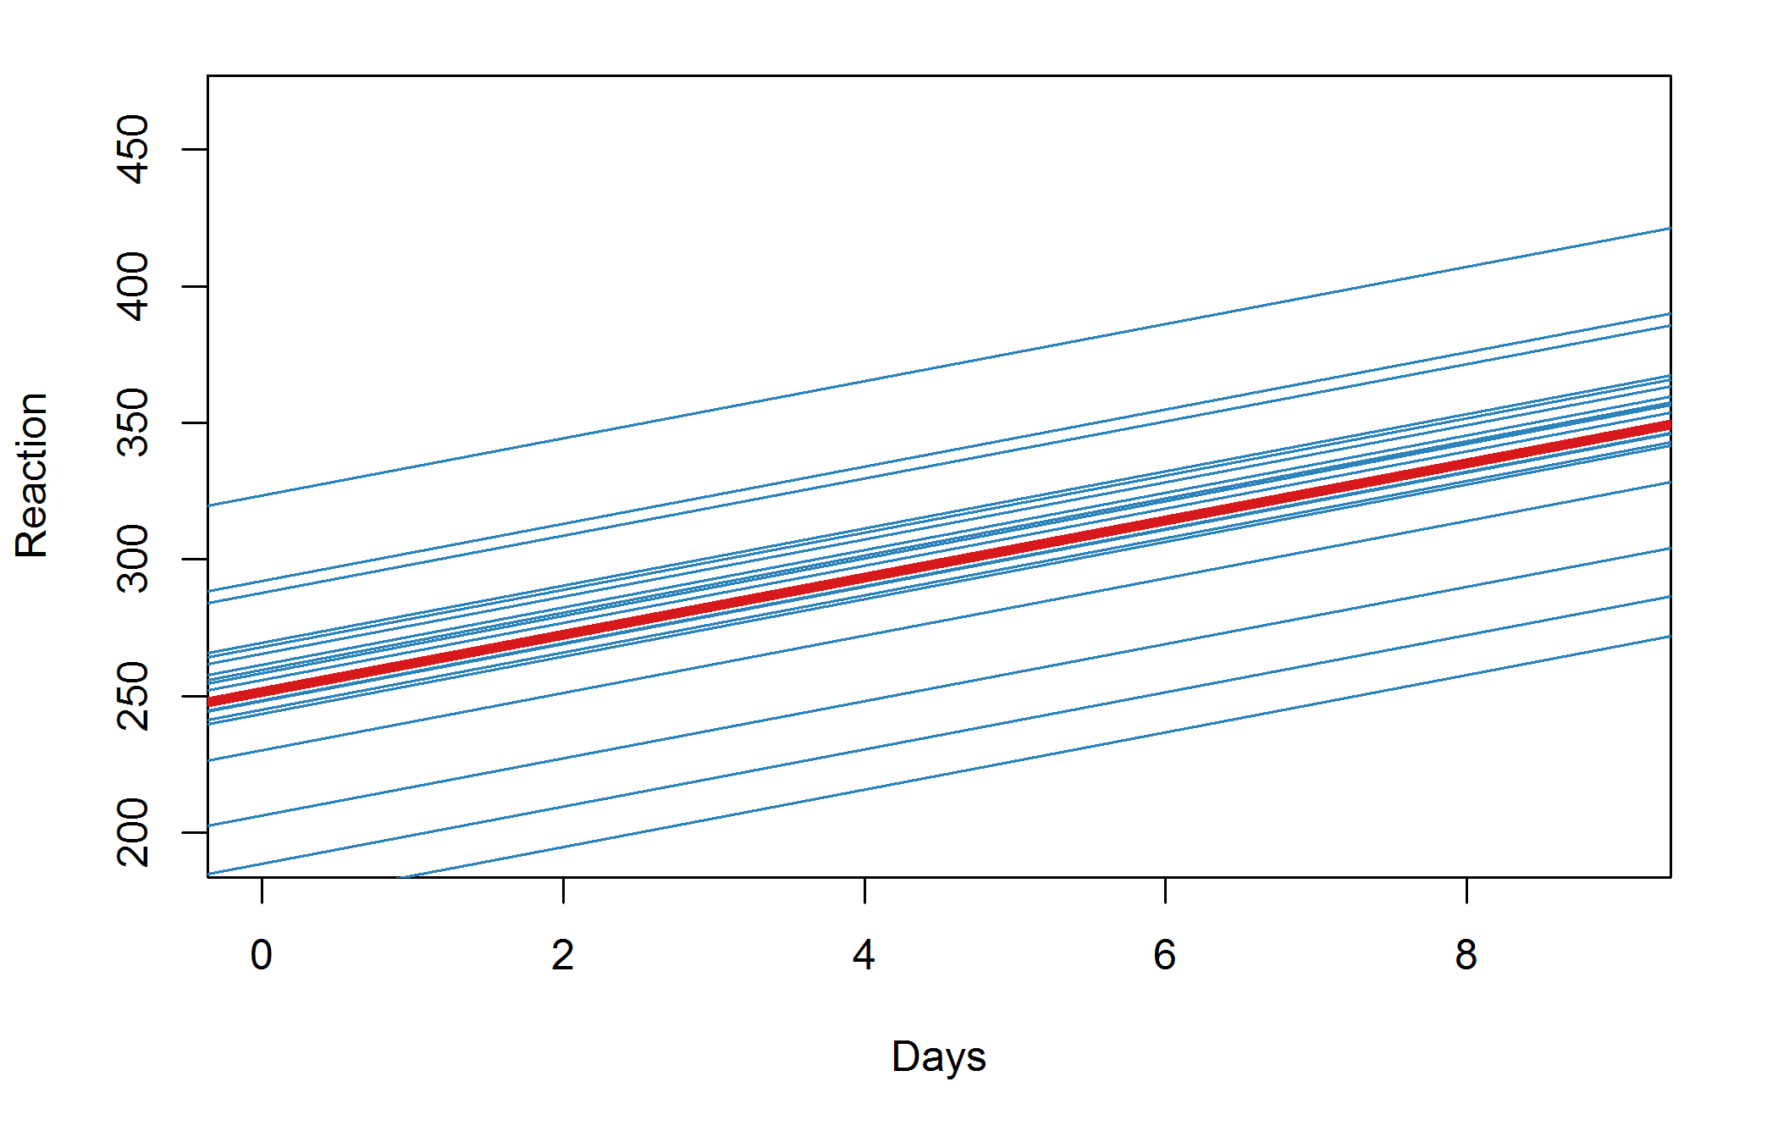
Less silly model

Slide 25
Average slope (slower reactions over time)

Slide 26
Intercept (still) varies by participant

Slide 27
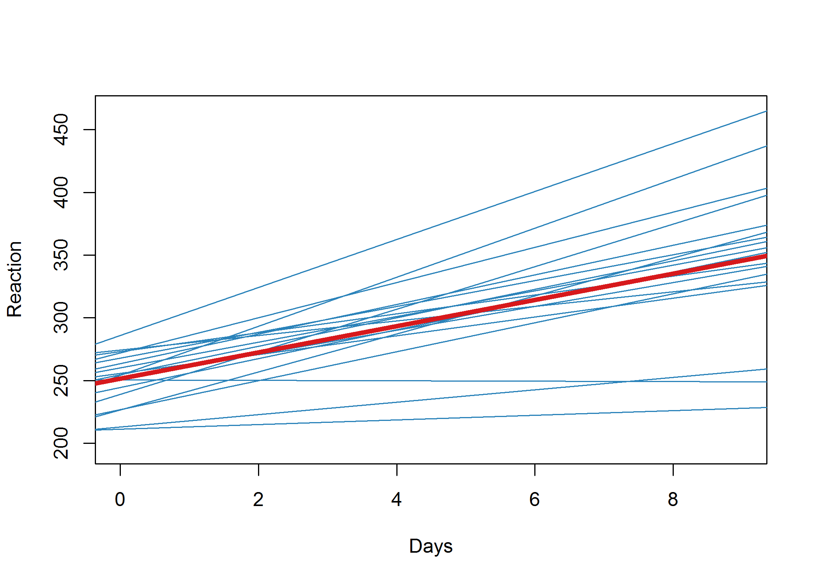
Better model

Slide 28
Now the slopes vary by participant too

Slide 30
Reaction ~ 1 + (1|Subject)

Slide 31
Reaction ~ 1 + Days + (1|Subject)

Slide 32
Reaction ~ 1 + Days + (Days|Subject)

Slide 33
What goodies do we get?
Random effects:
Groups Name Variance Std.Dev. Corr
Subject (Intercept) 612.09 24.740
Days 35.07 5.922 0.07
Residual 654.94 25.592
Number of obs: 180, groups: Subject, 18
Fixed effects:
Estimate Std. Error t value
(Intercept) 251.405 6.825 36.84
Days 10.467 1.546 6.77
Correlation of Fixed Effects:
(Intr)
Days -0.138

Slide 34
Gelman (2005)
‘We prefer to sidestep the overloaded terms “fixed” and “random” with a cleaner distinction […]. We define effects (or coefficients) in a multilevel model as constant [fixed] if they are identical for all groups in a population and varying [random] if they are allowed to differ from group to group.’
Gelman A. (2005). Analysis of variance— why it is more important than ever. Annals of Statistics, 33, 1–53

Slide 35
How to think about random effects
They are like residuals
(in fact residuals are random effects)
But they can be at higher levels in the dataset, e.g.,
slopes
intercept
by school, class, participant, …

Slide 36
Random effects: tells you about the variation at different levels
Random effects:
Groups Name Variance Std.Dev. Corr
Subject (Intercept) 612.09 24.740
Days 35.07 5.922 0.07
Residual 654.94 25.592
Number of obs: 180, groups: Subject, 18

Slide 37
Fixed effects – interpret as for regression: mean change
Estimate Std. Error t value
(Intercept) 251.405 6.825 36.84
Days 10.467 1.546 6.77
Correlation of Fixed Effects:
(Intr)
Days -0.138

Slide 38
Interactive entertainment
Read in the sleepstudy.csv dataset
Make the “Subject” variable a factor
Try the following library(lattice) xyplot(Reaction ~ Days | Subject, data = dat)

Slide 39
More entertainment
Use the lmer command to fit the models depicted in previous pictures:
Average intercept and allow the intercept to vary by subject
Average intercept and average slope for Days; again allow the intercept to vary by subject
Same as b, but additionally allow the slope to vary by Days
What changes across the model summaries…?

Slide 40
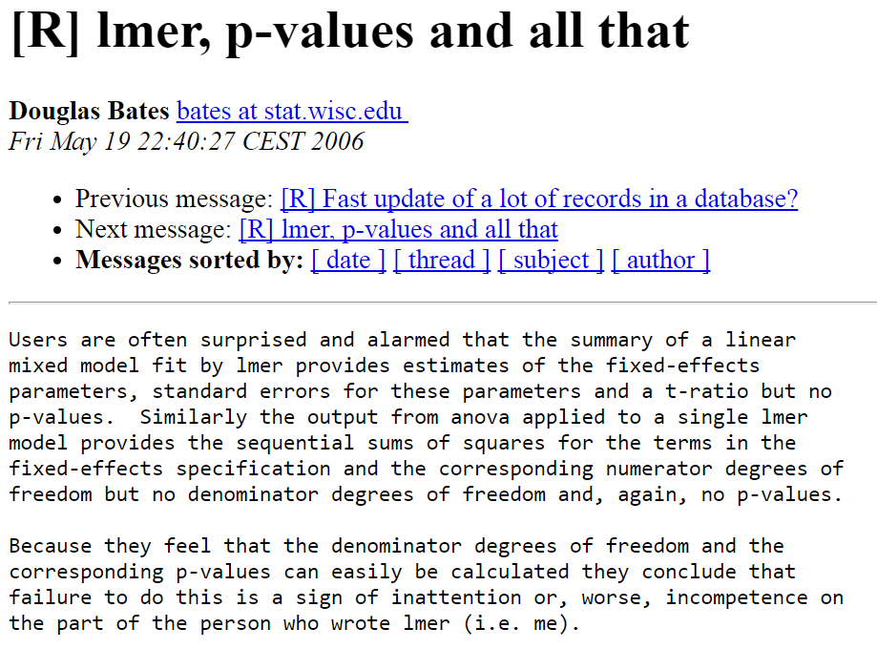

Slide 41
Solution 0
The anova command still works and gives you a log-likelihood ratio test with p-values (and other goodies).
refitting model(s) with ML (instead of REML)
Data: dat
Models:
lmm0: Reaction ~ 1 + (1 | Subject)
lmm1: Reaction ~ Days + (1 | Subject)
Df AIC BIC logLik deviance Chisq Chi Df Pr(>Chisq)
lmm0 3 1916.5 1926.1 -955.27 1910.5
lmm1 4 1802.1 1814.8 -897.04 1794.1 116.46 1 < 2.2e-16 ***

Slide 42
Solution 1
Use confidence intervals instead. These do work for lmer!
confint(model name)
Remember this command also works for lm and glm and polr

Slide 43
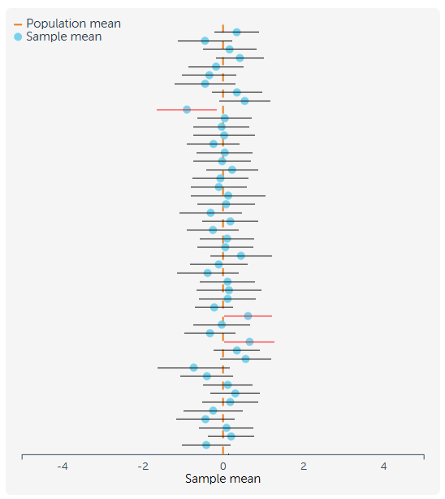
It assumes you remember what a confidence interval is. Reminder:
Suppose you ran the same study many times using samples the same size from the same population
In 95% of studies, the 95% confidence interval includes the true value.
rpsychologist.com/d3/CI

Slide 44
Solution 2
Use Alexandra Kuznetsova et al.’s
lmerTest package
This fixes the standard summary command so it includes an approximate p-value. So just do:
library(lmerTest)
summary(model name)

Slide 45
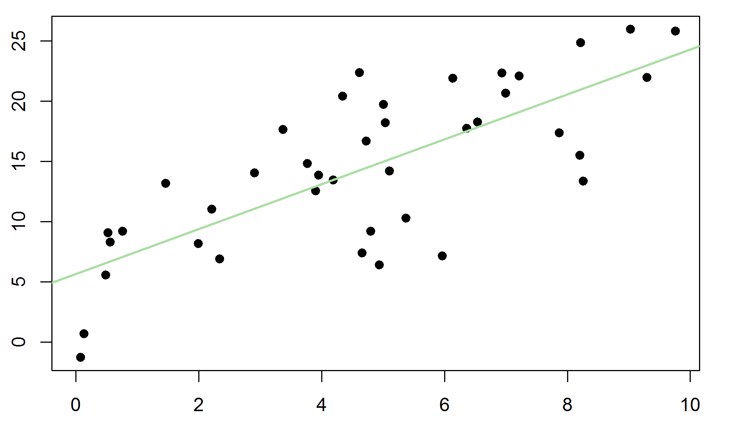
Summary
Multilevel models are
extensions of regression
Allow multilevel data, like students in classrooms (in schools (in counties (in countries)))…
Describing
variation at different levels
+ average relationships

Slide 46
The end

